Slide 1

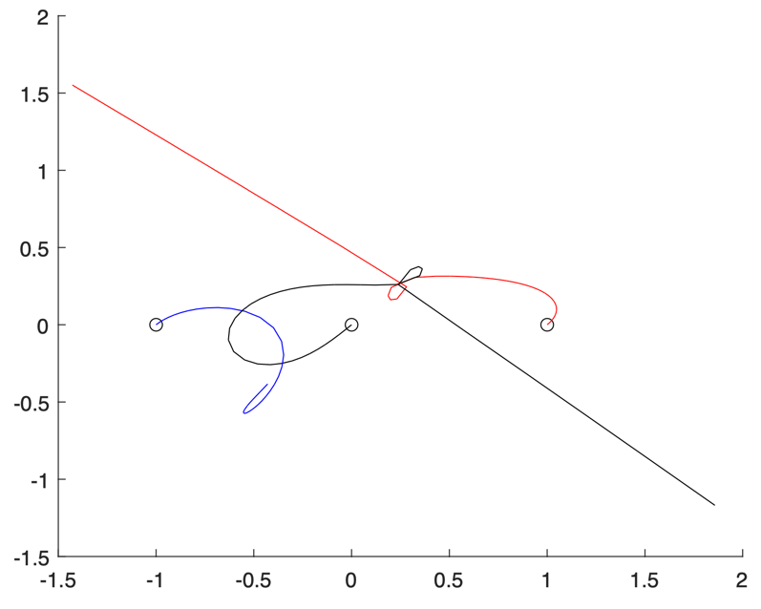
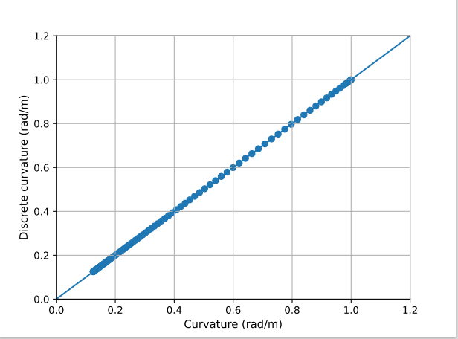
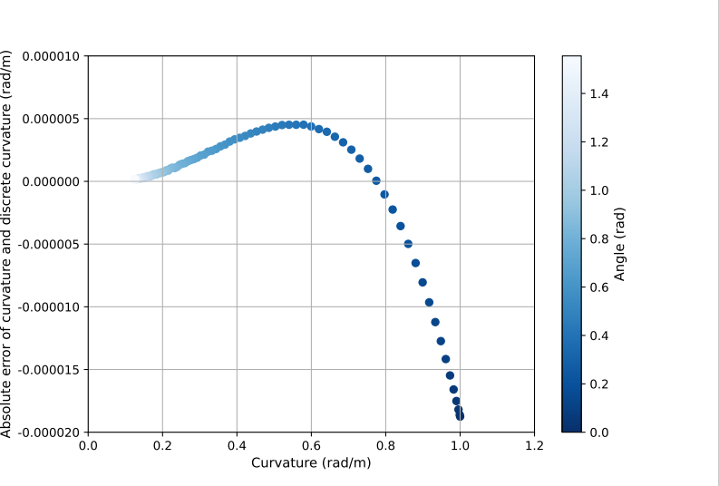
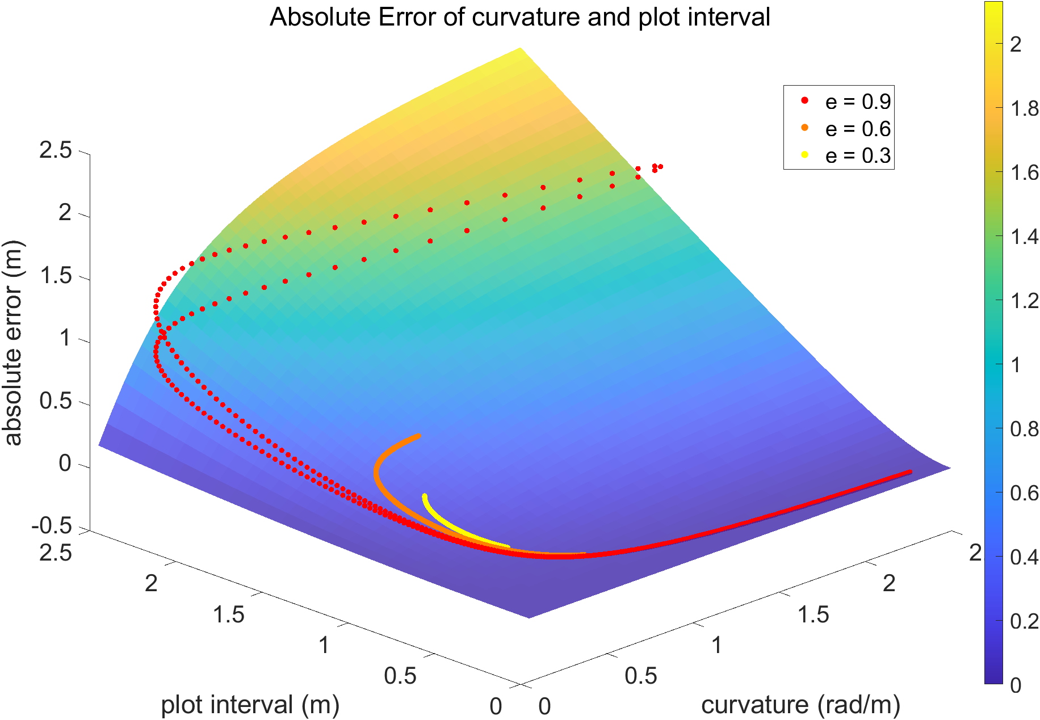
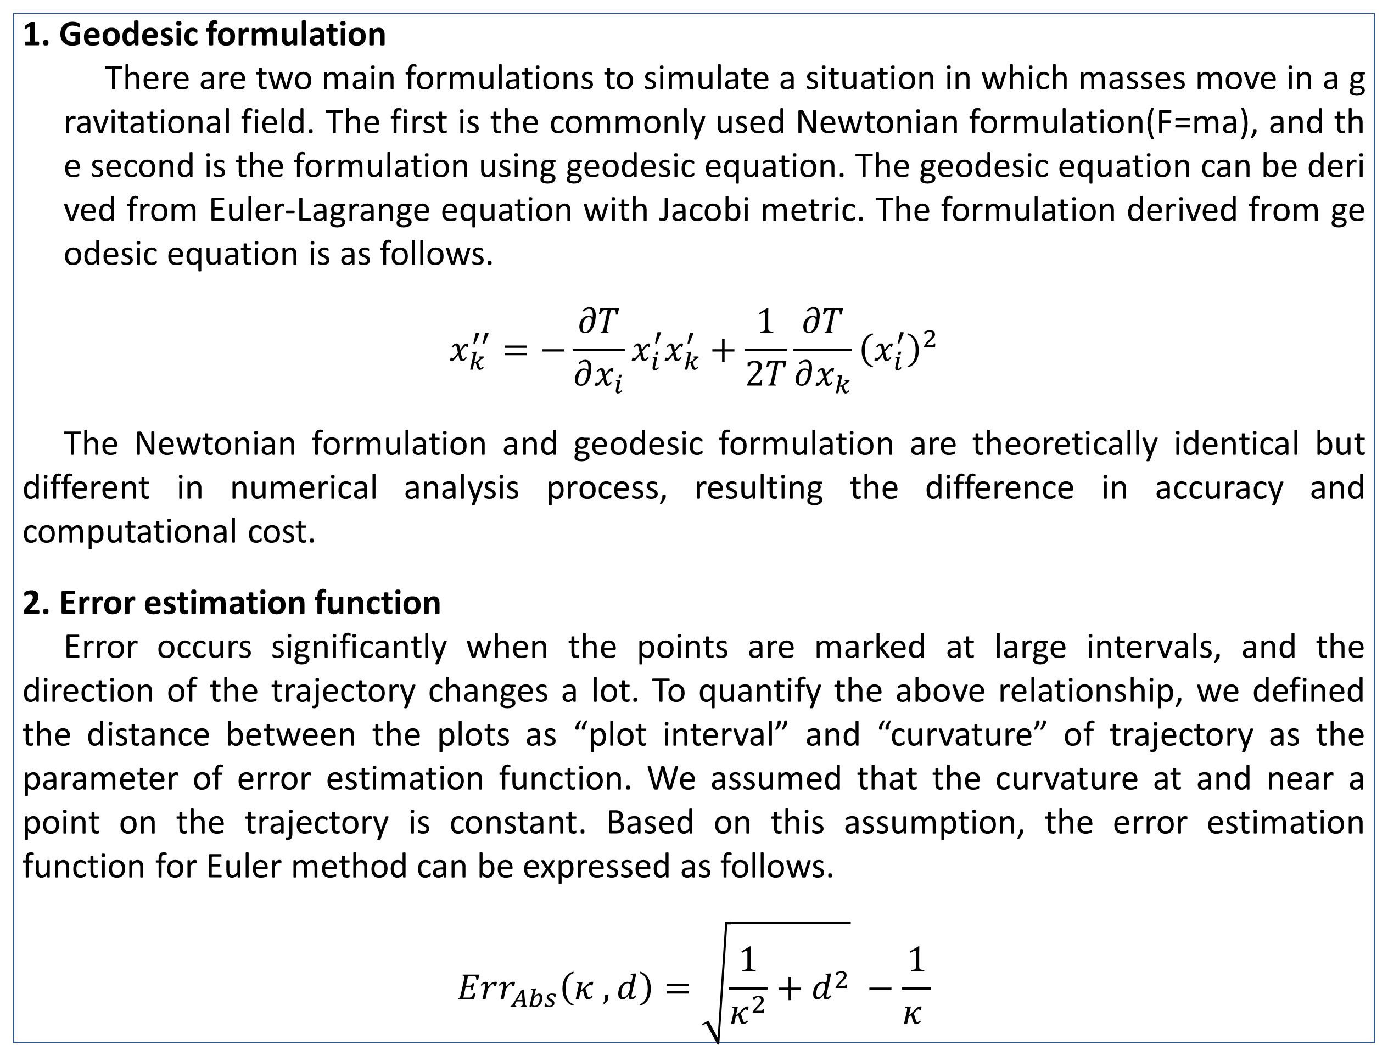
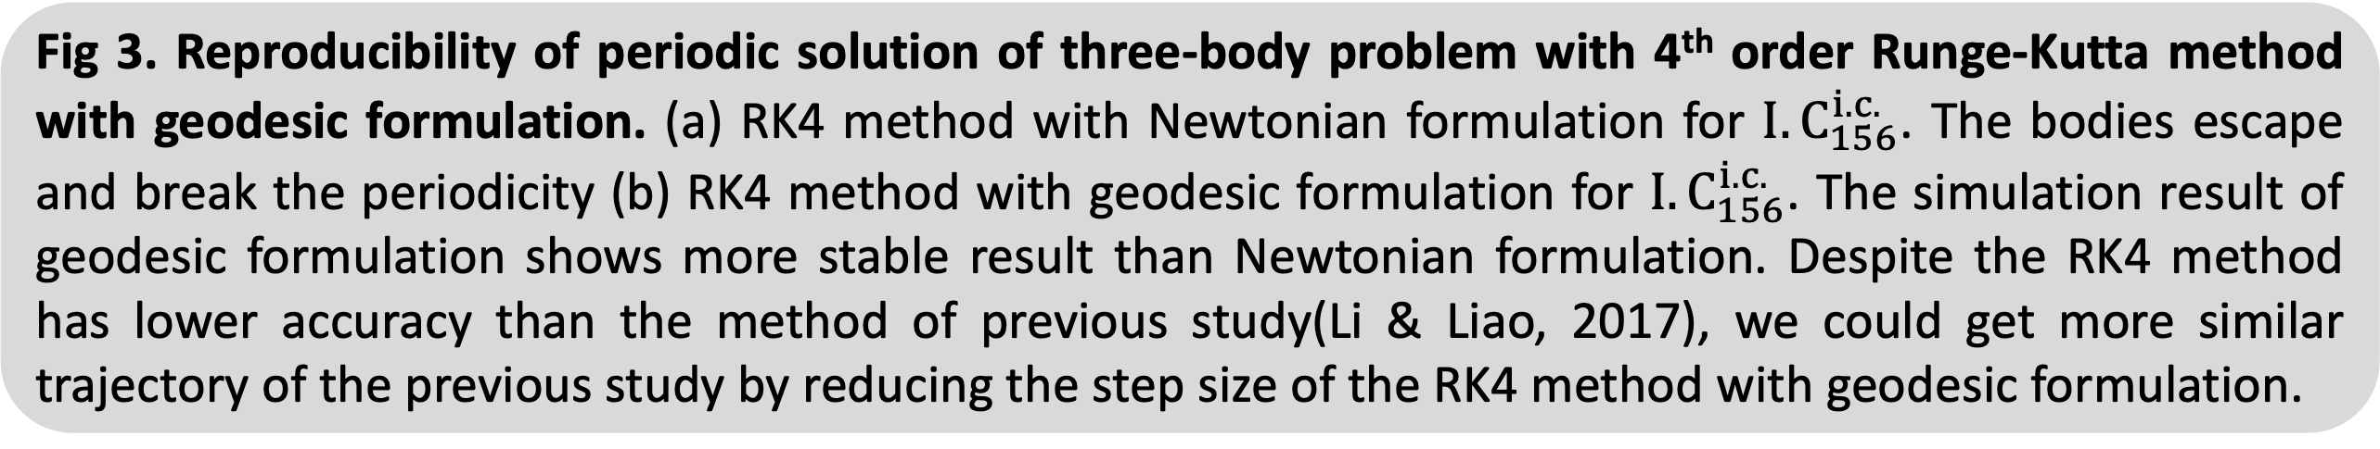
Visualization of trajectories in gravitational fields as geodesic: Focused on Kepler problems
CHO Suho¹, KANG Hyosang^{1*}, KIM Hyeongjun¹, KIM Jaeseok¹, KIM Mingeun¹, SUNG Hyungue David¹
¹ School of Undergraduate Studies, DGIST, Daegu, Korea
* Correspondence to hyosang@dgist.ac.kr
Abstract
(a)
(b)
The three-body problem concerns the motion of three objects affected by gravity. Since the three-body problem does not admit a closed-form solution in general, the studies on the three-body problem have been focused mainly on finding its periodic solutions using numerical methods. To obtain a numerical solution to the three-body problem, we can use Newtonian mechanics or Lagrangian mechanics. The latter is due to Euler-Lagrange equation, which is equivalent to the geodesic equation on the Lagrangian system. We compare accuracies between numerical solutions of Newtonian mechanics and the geodesic equation for the Lagrangian system. We observe that the latter solution is more accurate on Kepler problem with Runge-Kutta method. We show that the geodesic equation gives more accurate estimation of the periodic solutions of the three-body problem with a long cycle than Newtonian mechanics.
Fig 2. Accumulated error comparison between Newtonian formulation and Geodesic formulation in 1st order Euler’s method. (a) Comparison of sum of the relative errors occurred in a cycle of elliptical orbit. (b) Comparison of sum of the relative error divided by the number of plots. In all eccentricity, the geodesic formulation showed a smaller accumulative error than the Newtonian formulation.
Key words
Geodesic, Kepler problem, Lagrangian system, Runge-Kutta method, Three-body problem
(a)
(b)
Theoretical backgrounds
1. Geodesic formulation
There are two main formulations to simulate a situation in which masses move in a gravitational field. The first is the commonly used Newtonian formulation(F=ma), and the second is the formulation using geodesic equation. The geodesic equation can be derived from Euler-Lagrange equation with Jacobi metric. The formulation derived from geodesic equation is as follows.
$$x_{k}^{′′}=−\frac{∂T}{∂x_{i}}x_{i}^{′}x_{k}^{′}+\frac{1}{2T}\frac{∂T}{∂x_{k}}{\left(x_{i}^{′}\right)}^{2}$$
The Newtonian formulation and geodesic formulation are theoretically identical but different in numerical analysis process, resulting the difference in accuracy and computational cost.
2. Error estimation function
Error occurs significantly when the points are marked at large intervals, and the direction of the trajectory changes a lot. To quantify the above relationship, we defined the distance between the plots as “plot interval” and “curvature” of trajectory as the parameter of error estimation function. We assumed that the curvature at and near a point on the trajectory is constant. Based on this assumption, the error estimation function for Euler method can be expressed as follows.
$$Err_{Abs}\left(κ , d\right)=\sqrt{\frac{1}{κ^{2}}+d^{2}} −\frac{1}{κ }$$
d
Fig 3. Reproducibility of periodic solution of three-body problem with 4th order Runge-Kutta method with geodesic formulation. (a) RK4 method with Newtonian formulation for ${I.C}_{156}^{i.c.}$. The bodies escape and break the periodicity (b) RK4 method with geodesic formulation for ${I.C}_{156}^{i.c.}$. The simulation result of geodesic formulation shows more stable result than Newtonian formulation. Despite the RK4 method has lower accuracy than the method of previous study(Li & Liao, 2017), we could get more similar trajectory of the previous study by reducing the step size of the RK4 method with geodesic formulation.
(a)
(b)
Results
(a)
(b)
Fig 4. Discrete curvature at curve of known exact curvature
Since the curvature cannot be analytically known in the three-body problem, they must be defined discretely in the numerical analysis. The “discrete curvature” would be different from the actual values, however they are expected to be used for relative comparison of efficiency between the Newtonian formulation and the geodesic formulation. (a) Calculate discrete curvature and curvature at points of a particular ellipse. It seems that discrete curvature fit well at exact curvature. (b) Absolute error of discrete curvature. Discrete curvature have high accuracy and its absolute error has some tendency.
Discussion
Fig 1. Error estimation function and rate of curvature. (a) Error estimation function and relative error measured from simulation of circular orbits. Since the assumption is not need to circular orbits, there is no difference between the function and measurements. And even if it is not circular trajectory, it is expected to valid at step size small enough. (b) Absolute error measured from simulation of Kepler orbits. The error is greater than the circular orbit in all cases for the Kepler orbit, suggested by our theory. The error indicates higher value when the rate of curvature is positive than when it is negative.
The error occurring at starting point is determined by plot interval, curvature of trajectory, and the rate of change of the curvature
Plot interval depends on formulation type(geodesic or Newtonian), numerical setup(step size) and physical condition(kinetic energy, potential energy)
Curvature of trajectory only depends on the physical condition(velocity, mass, position)
The geodesic formulation is more efficient than Newtonian formulation
The geodesic formulation showed higher accuracy-to-calculation cost than Newtonian formulation for elliptical orbit of Kepler problem.
The RK4 geodesic formulation showed more stable trajectory than Newtonian formulation with same order for periodic solution of three-body problem.
If we know the plot interval, curvature of trajectory, and the rate of change of the curvature in discrete term, we could compare the relative accuracy-to-calculation cost between Newtonian formulation and geodesic formulation.
References
- Butcher, J. C. (1996). A history of Runge-Kutta methods. Applied numerical mathematics, 20(3), 247-260.
- Hestenes, D. (2012). New foundations for classical mechanics (Vol. 15). Springer Science & Business Media. - Li, X., & Liao, S. (2017). More than six hundred new families of Newtonian periodic planar collisionless three-body orbits. Science China Physics, Mechanics & Astronomy, 60, 1-7.
- Musielak, Z. E., & Quarles, B. (2014). The three-body problem. Reports on Progress in Physics, 77(6), 065901.

